Slide 1




CitiObs Roadshow Sessions
3 June 2026
AirLimnos
Korina Defteraiou, Panagiota Fabrikanou, Katerina Zourou, Stefania Oikonomou, Web2Learn
Funded by the European Union. Views and opinions expressed are however those of the author(s) only and do not necessarily reflect those of the European Union or the European Research Executive Agency (REA). Neither the European Union nor the granting authority can be held responsible for them.

Slide 2

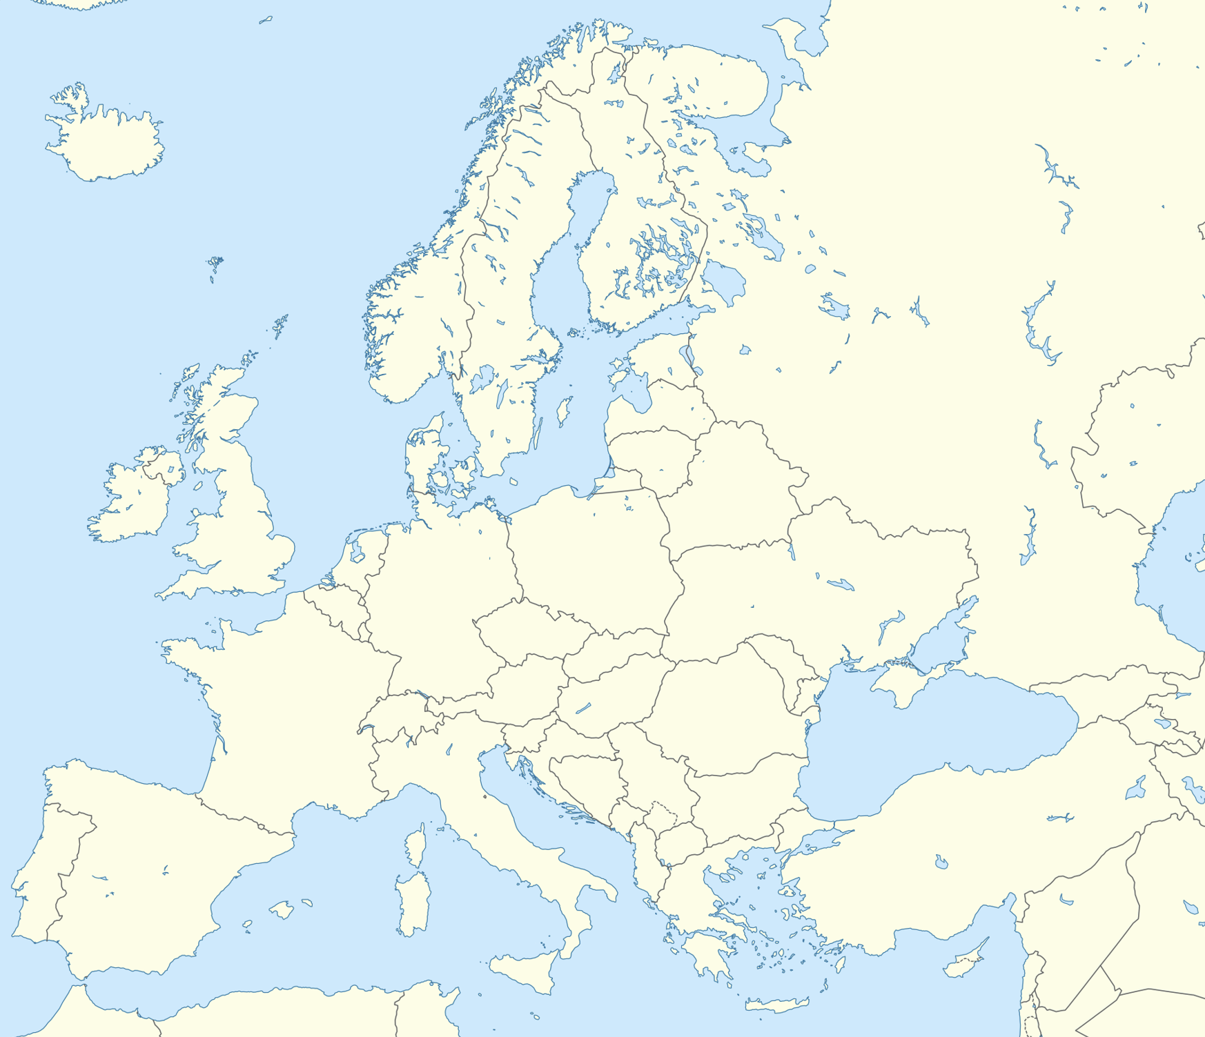
Myrina Jr. High School
Intercultural Jr. High School of Evosmos
25 students, 2 teachers
Livadochori Jr. High School
94 students, 4 teachers
April 2025
56 students, 1 teacher
Moudros High School
November 2025
Nautical Club of
Thessaloniki
30 students, 2 teachers
Moudros Jr. High School
March 2026
Lefkada 1st High School
90 students, 3 teachers
Agios Efstratios
April 2026
26 students, 1 teacher
Agios Dimitrios Junior High School
May 2026
28 students, 3 teachers
Piraeus 2nd Junior High School
Sivitanidio Evening Vocational High School
34 students, 3 teachers
30 students, 2 teachers

Slide 3
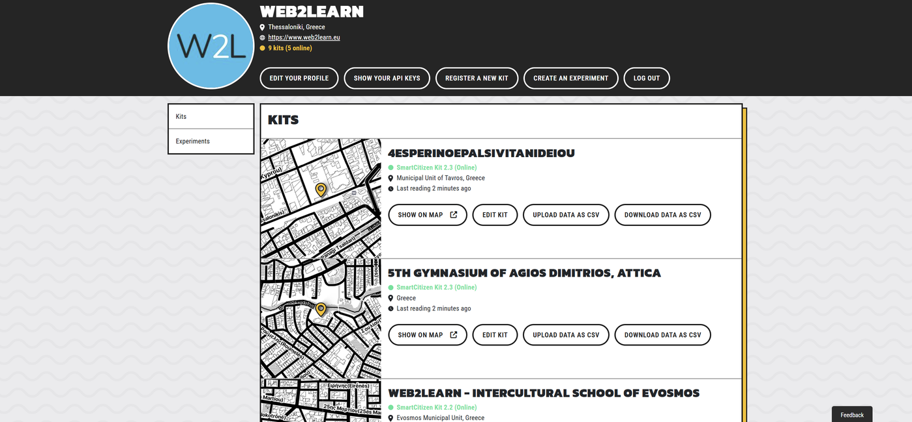
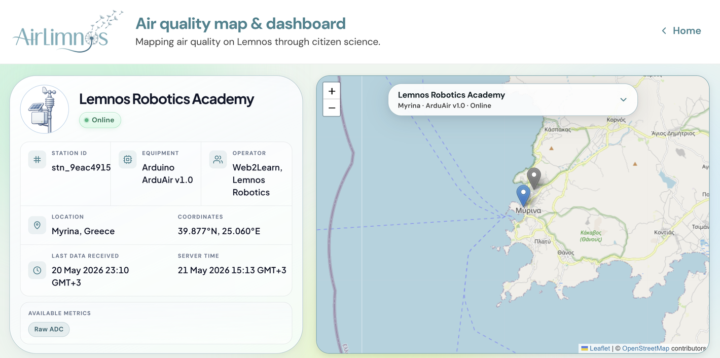

AirLimnos and Beyond
Capacity building
Data visualizations
CitiObs study visit in Brussels
14 October 2025
A new real time dashboard
https://api.smartcitizen.me/ui/users/Web2Learn
A new EU-funded project
Air monitoring for schools in France, Greece, and Portugal
https://web2learn.eu/airlimnos_dashboard/
STEAMies: Action-oriented air and water solutions for STEAM school education

Slide 4
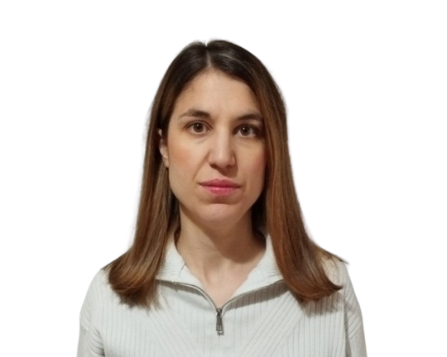





The Web2Learn Team
Education
Korina Defteraiou
Stefania Oikonomou
Panagiota Fabrikanou
Education and Outreach Executive
Research Collaborator
Education and Outreach Collaborator
Technology
Katerina Zourou
Managing Director
Andreas Kouzelis
Andreas Darsaklis
Information Systems Engineer
IT trainee

Slide 5
