Slide 1
“Module 1: Open innovation in academia-society cooperation: examples of cultural heritage preservation in situations of crisis”
Web2Learn team: Katerina Zourou, Stefania Oikonomou,
Mariana Ziku, Anna Skowron
March 7, 2023

Slide 2
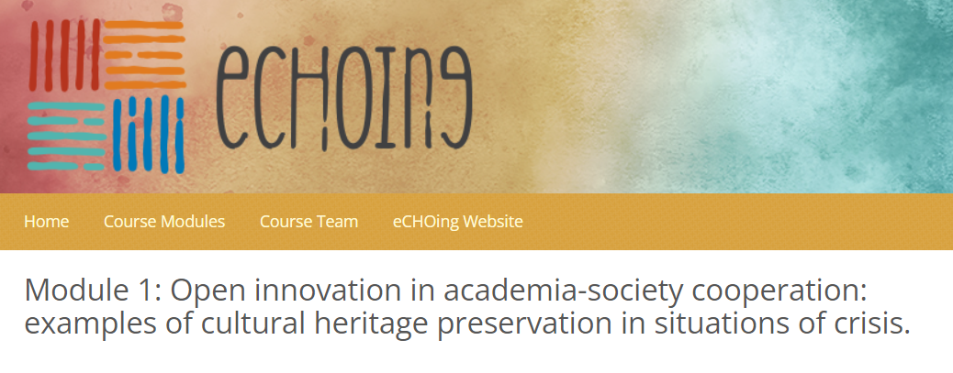
Open innovation in academia-society cooperation: examples of cultural heritage preservation in situations of crisis
=> To act for the cultural heritage sector, and to raise awareness of the action-driven impact of citizens to preserve a cultural continuum in an armed conflict.
Special case study: Ukrainian cultural heritage under threat
https://sisu.ut.ee/echoing/course-modules?lang=en

Slide 3
Learning objectives
Understand open innovation as a form and a means of citizen engagement;
Identify how academia-society cooperation in crises has been further developed through open innovation;
Analyse concrete examples of open innovation-driven initiatives in the cultural heritage sector to tackle the Ukrainian crisis;
Plan mixing and matching activities that support citizen engagement.

Slide 4
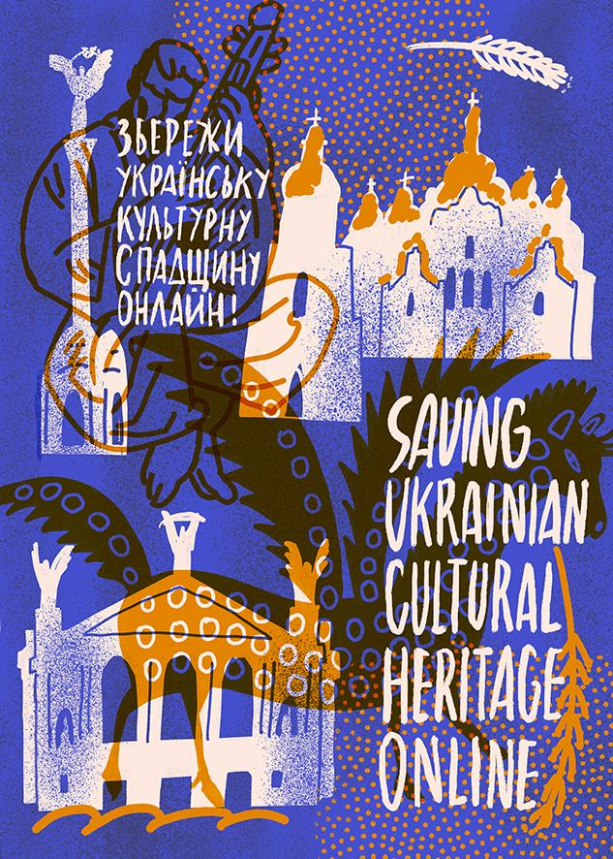
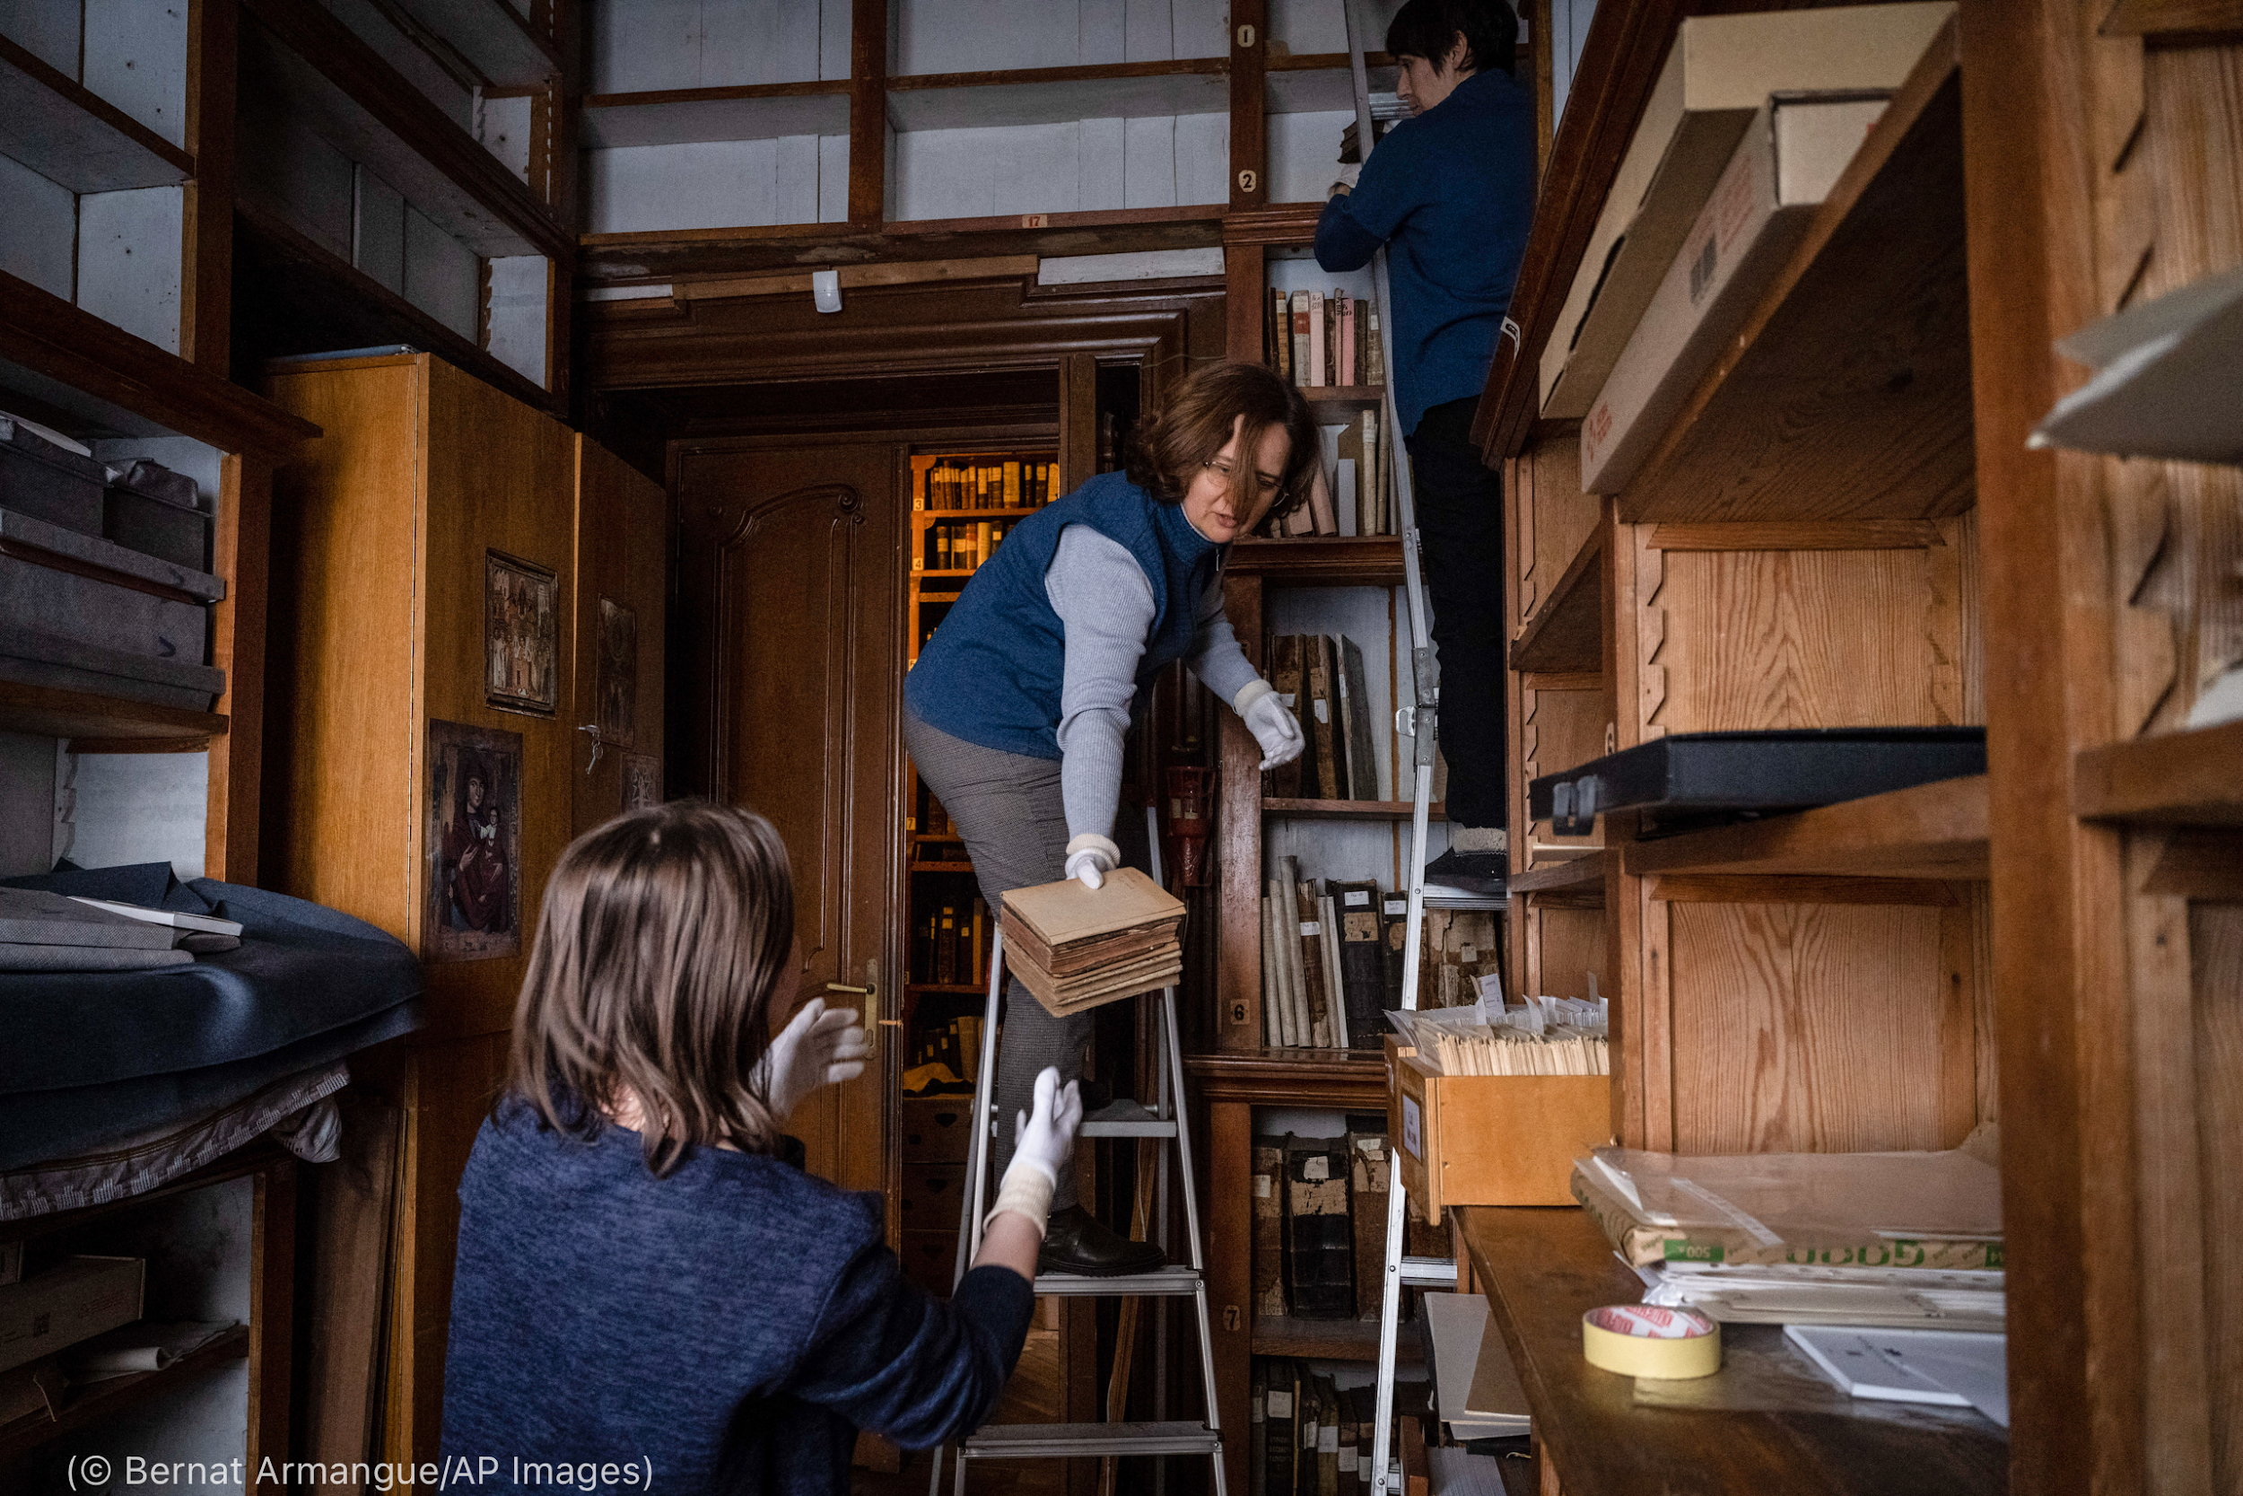
Content
Unit 1: Open Innovation as crisis response in academia-society cooperation
Unit 2: Open Innovation as a response to cultural heritage crises and the role of academia-society cooperation
Unit 3: Case study: Impact on Ukrainian cultural heritage
Unit 4: Open innovation in academia-society cooperation
Unit 5: A concrete example of an open innovation initiative for cultural heritage in times of crisis

Slide 5
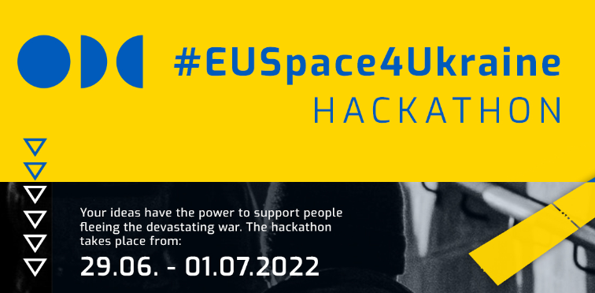
Types of citizen engagement in open innovation
Crowdsourcing
Crowdfunding
Hackathons
Maker movement
=> Aim: Foster citizen engagement in the protection and preservation of cultural heritage through open innovation.

Slide 6
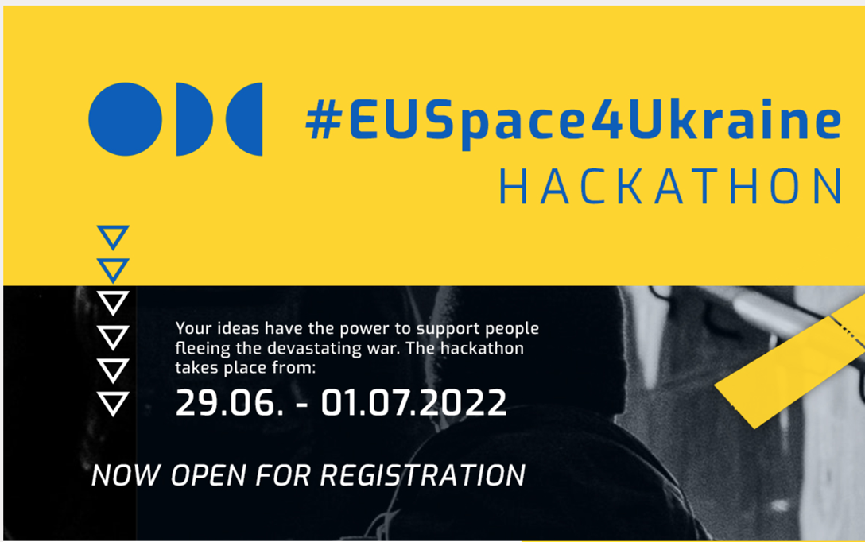
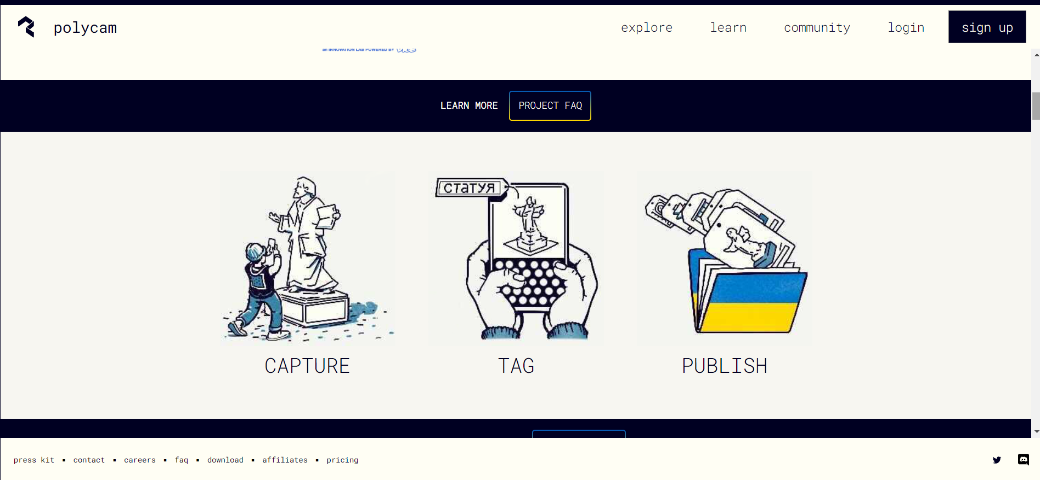
#EUSpace4Ukraine hackathon
BackUp Ukraine
Open Innovation actions
Hackathon4Ukraine
SUCHO
Notes:
The first group of actions belongs to what we call open innovation. Open innovation is an umbrella term that covers actions like hackathons, crowdfunding, maker spaces and fab labs. Open innovation is about communities of enthusiasts who use any sort of technologies, including do-it-yourself tools, for their social purpose.
In our collection, we have spotted 2 hackathons that addressed Ukrainian community needs.
Hackathons are quick, 2-day events that bring together groups of people solving a specific problem and the best solutions are awarded. The one is the EUSpace4Ukraine hackathon Bente was referring to earlier. The hackathon was run by the European Agency for the Space Programme.
The second one is a hackathon organised by HE students from the Warsaw University of Technology and Imperial College London on March 2022. The aim of both hackathons was to develop digital solutions in support of Ukrainian citizens to cover various social purposes, including cultural heritage.
Then, there are 2 other actions which focus exclusively on cultural heritage preservation.
BackUp Ukraine is such an example. Here, citizens scanned Ukrainian monuments with their phones by using a mobile application. Then, these images were produced as 3D models and digitally preserved in an open access archive.
The 4th action, that you may be aware of already thanks to a talk by Sebastian Majstorovic at the Europeana conference yesterday is SUCHO: Saving Ukrainian Cultural Heritage Online.
SUCHO was set up by a group of HE staff and researchers. In this initiative, volunteers coming from different professional backgrounds engage in saving by archiving digital content and data of Ukrainian CHIs. This action grew exponentially and now it counts over 1.500 volunteers that have preserved more than 50TB of data.

Slide 7
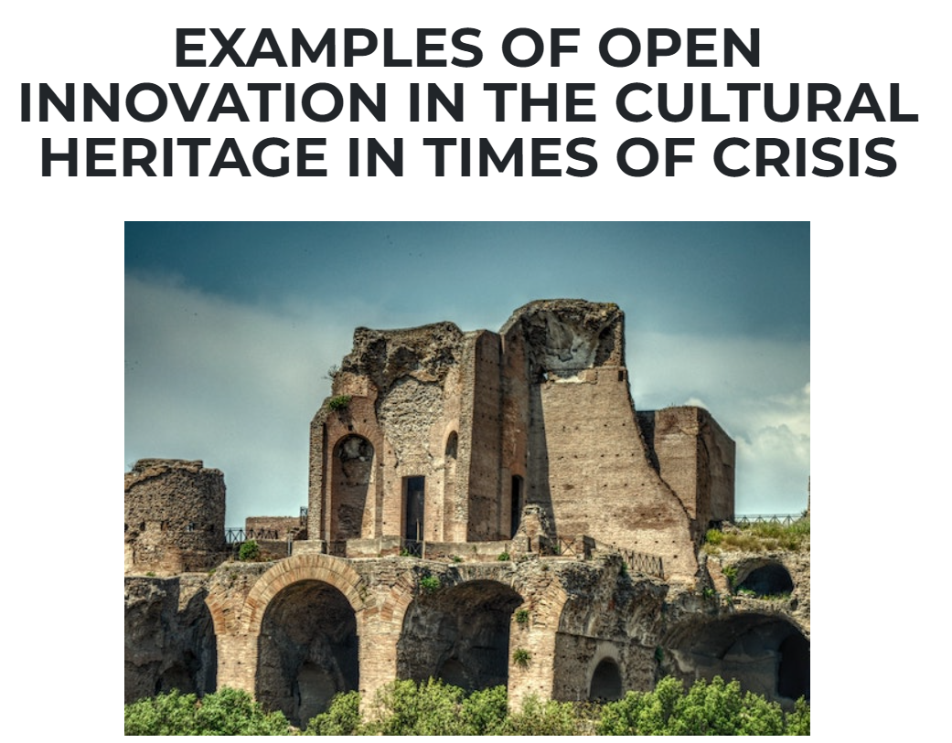
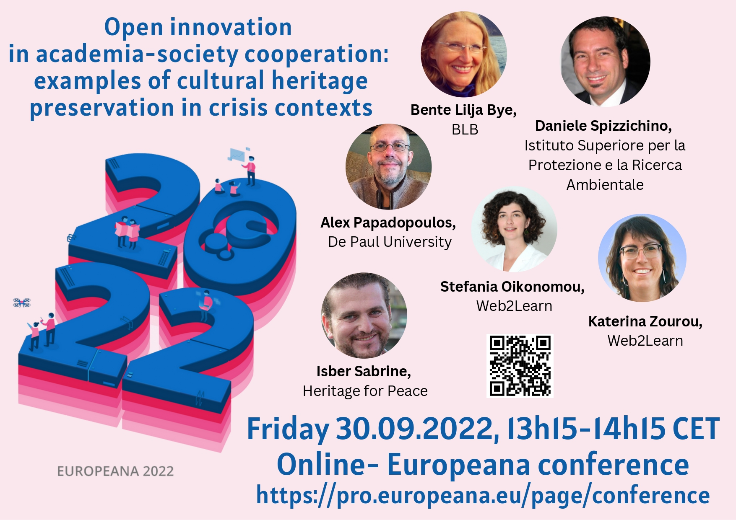
Web2Learn actions for Ukrainian cultural heritage since February 2022
Open access collection of open innovation initiatives to safeguard Ukrainian cultural heritage. Collection available on github;
Webinar “Cultural heritage threats and the role of citizen engagement inside and outside universities”, June 2022 Recording;
Award for 3rd place at the #EUSpace4Ukraine hackathon with a Challenge on (Ukrainian) “Cultural heritage under threat”;
Europeana Conference 2022 workshop; “Open innovation in academia-society cooperation: examples of cultural heritage preservation in a crisis situation”.
https://web2learn.eu/a-series-of-actions-to-support-ukrainian-people-focusing-particularly-on-the-ukrainian-cultural-heritage/

